Slide 1
Connecting To DataBases
Oracle,DB2,SQL Server,SAP HANA Databases

Slide 2
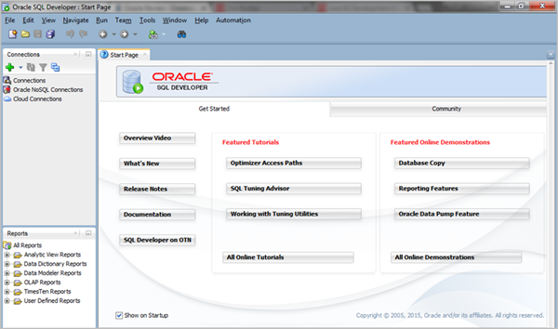
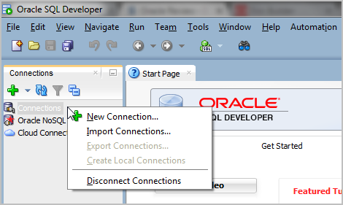
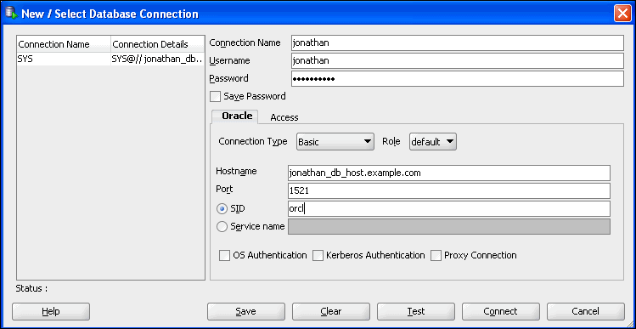
Oracle Database Connection Via Oracle SQL Developer
Parameter Needed:
USERNAME
PASSWORD
HOSTNAME
PORT
SID/SERVER NAME
Source: https://docs.oracle.com/en/cloud/paas/exadata-express-cloud/csdbp/connect-sql-developer.html#GUID-00D45398-2BF3-48D5-B0E9-11979D5EAFFC

Slide 3
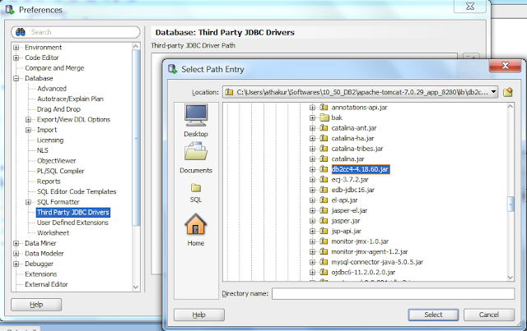
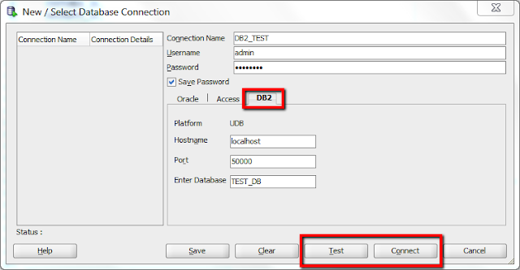
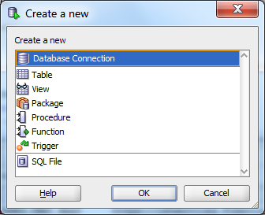
DB2 Connection Via Oracle SQL Developer
Step 1: Download the JDBC driver for DB2 . It will be something like db2cc4-4.18.60.jar.
Step 2: Next go to your SQL developer. Go to Tools -> Preferences -> Databases -> Third party JDBC drivers and click on "Add Entry". Next select the driver jar you downloaded in step 1.
Step 3: Next go to New (Ctrl + N) and select database connection. Provide details about your connection. Don't forget to select database type as DB2 rather than oracle (see screenshot) and provide your db details.
Step 4. You can test your connection and save or connect to it. After this you should be good to execute queries on your DB2 database from SQL developer.
Parameter Needed:
USERNAME
PASSWORD
HOSTNAME
PORT
Database
Source: http://opensourceforgeeks.blogspot.com/2015/12/using-sql-developer-for-connecting-to.html

Slide 4
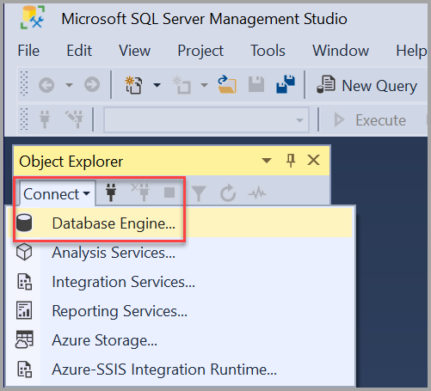
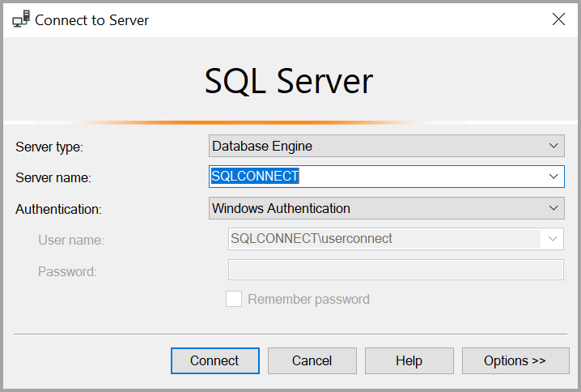
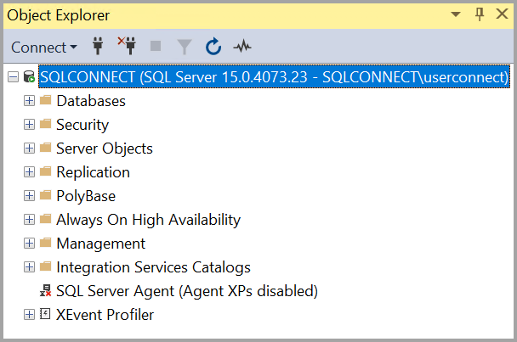
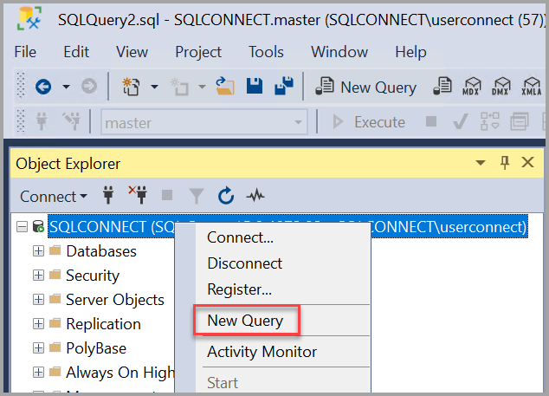
SQL Server Instance Connection Via SQL Server Management Studio
Parameter Needed:
Server Type
Server Name
Authentication (Windows/SQL Server)
User ID
Password
Source: https://docs.microsoft.com/en-us/sql/ssms/quickstarts/ssms-connect-query-sql-server?view=sql-server-ver15

Slide 5
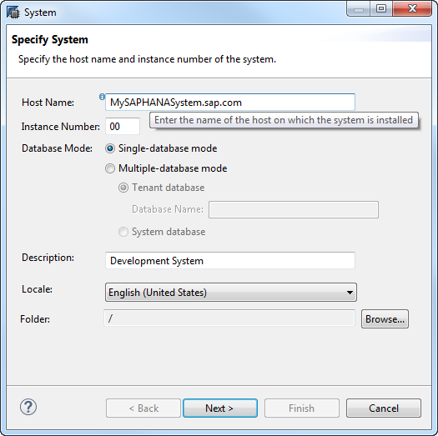
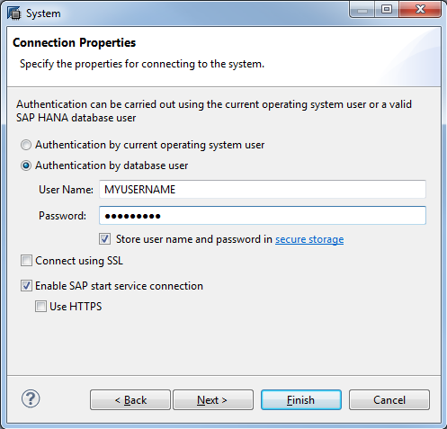
SAP HANA Database Connection Via SAP HANA Studio
Step 1: Open SAP HANA studio
Step 2: Open the SAP HANA Development perspective.
Step 3: In the Systems view, click [+] Add System... and choose Add System…
Step 4: Type the details of the SAP HANA system in the following fields
1. HostName
2. Instance Number
3. Description
Step 5: Click NEXT, Enter Username and password by Database User Authentication
Source: https://help.sap.com/viewer/400066065a1b46cf91df0ab436404ddc/2.0.02/en-US/abedb1c22b0746a8a44a38b810c99b58.html

Slide 6
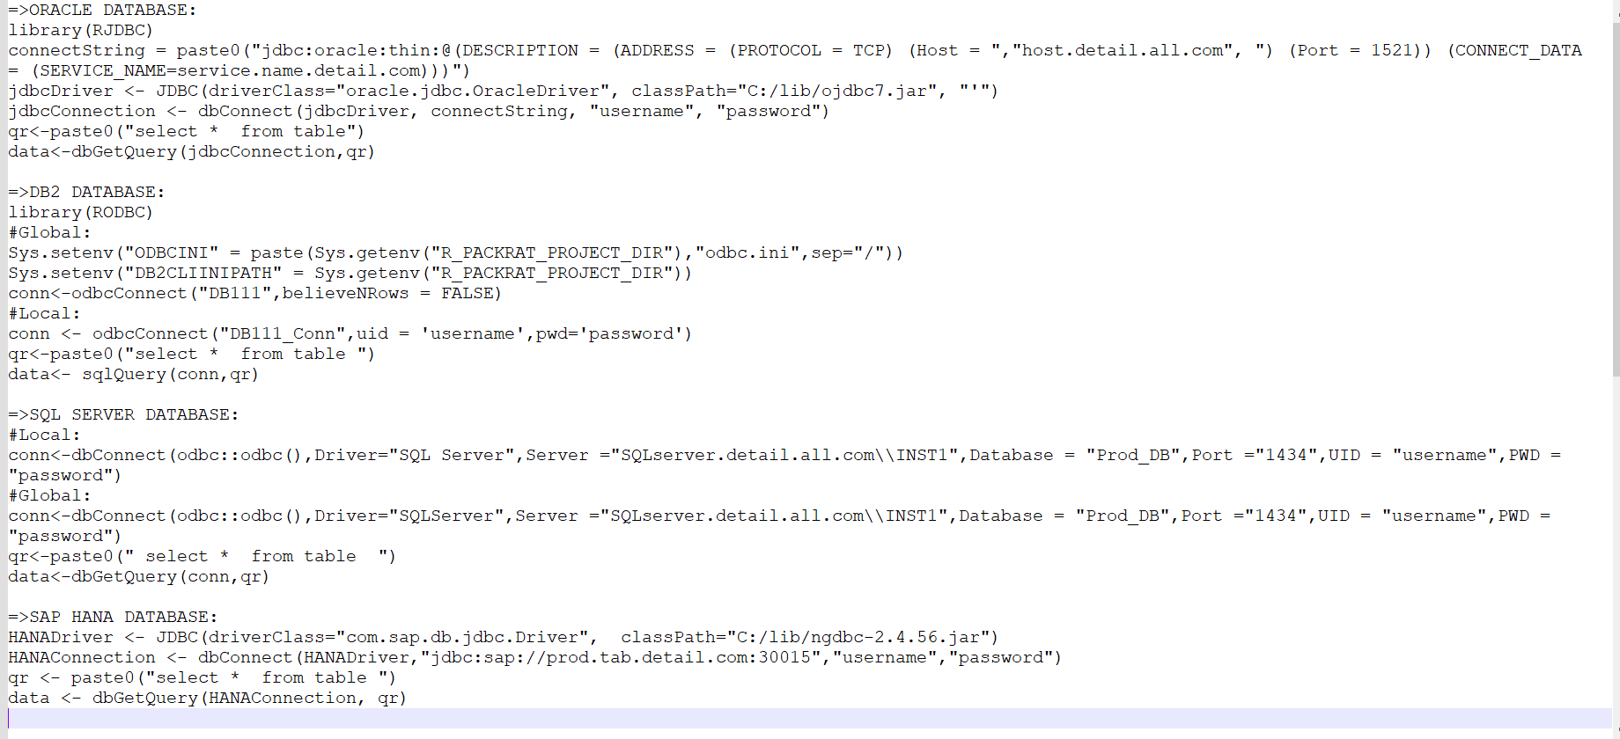
Connecting to Databases from R
For guide: https://db.rstudio.com/databases/

Slide 7
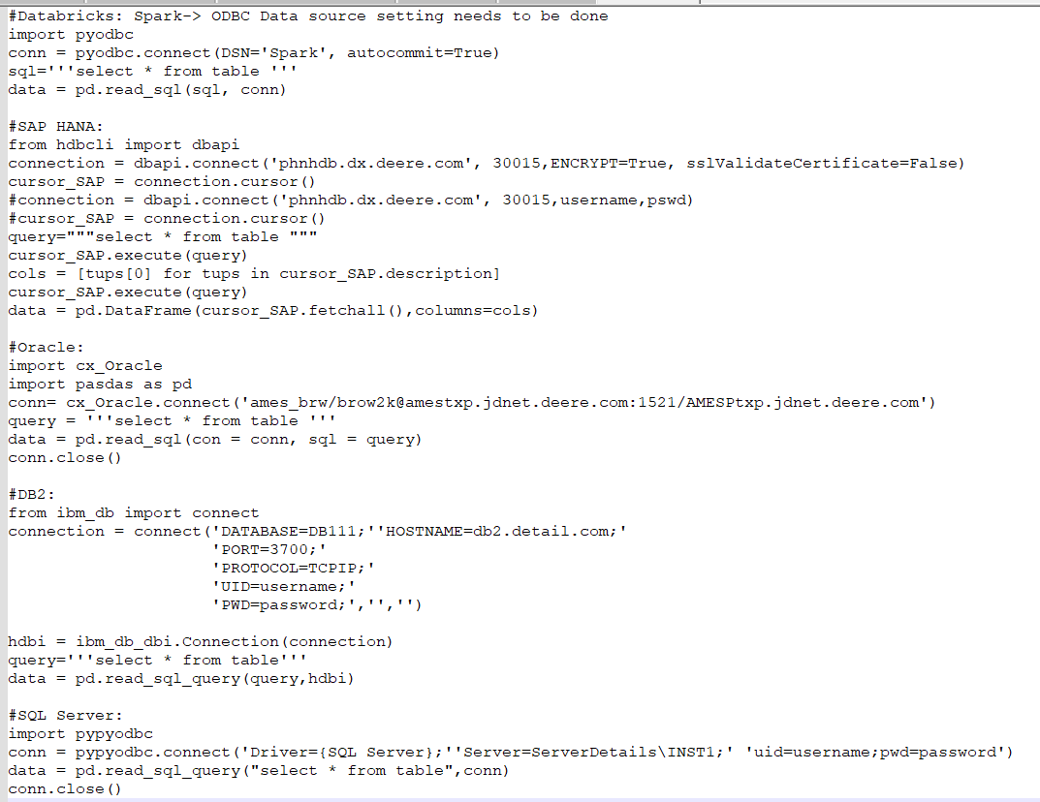
Connecting to Databases from Python

